Slide 1
Managed Instances NDA content
Jes Borland
PFE, SQL Server

Slide 2
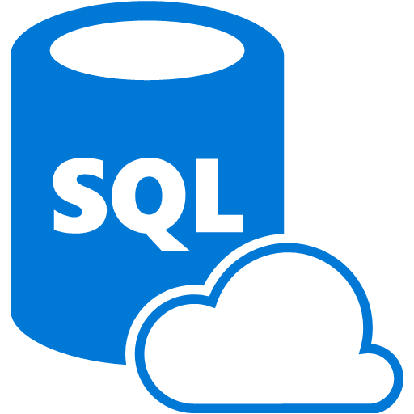
The benefits of SQL Database
Automatic management of patches, updates, and backups
Easy scalability
Cloud-first feature development

Slide 3
The drawbacks of SQL Database
Limited surface area - major features missing
No way to tie to a virtual network
Lack of cross-database communication

Slide 4
Solving the problem
Managed Instances: a PaaS offering combining the managed services of SQL Database with the compatiblity and server-level options of SQL Server

Slide 5
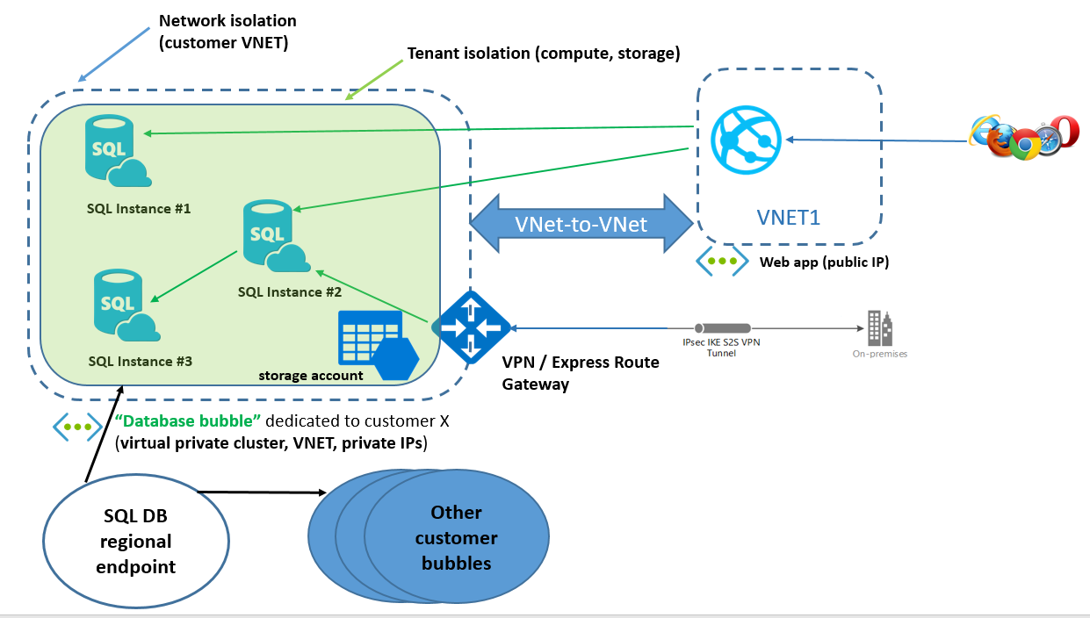
Benefits
Near-100% feature compatibility with SQL Server
Ability to isolate within a vnet

Slide 6
Compatibility being introduced
Cross-database queries
Cross-instance queries
Global temp tables
CLR
R services
SQL Audit
SQL Agent
Database mail
Change Data Capture
Service Broker
Transactional Replication
Log Shipping
Resource Governor

Slide 7
Scaling
Managed Instances will offer the same ability to scale up/down as SQL Database does

Slide 8
HA/DR
Matches SQL Database features
Automatic backups
Point-in-time restore
Geo-replication

Slide 9
Security
Connecting to Managed Instances
Windows Authentication isn't supported
Azure Active Directory will be
Active Directory Integrated Authentication will be
Data
Fully compatible with column encryption, TDE, Always Encrypted

Slide 10
Migrating data to Managed Instances
Full native restore
Log ship
DMS (Database Migration Service)
Export and import a bacpac
Move data with SSIS
Set as transactional replication subscriber

Slide 11
What can be migrated?
Data
Logins
Credentials
Jobs

Slide 12
Performance tuning tools
Matches SQL Database options
Query Performance Insight
Automatic Tuning
Threat Detection

Slide 13
Questions?

